Slide 1
Combinational Logic with MSI and LSI
Unit-4

Slide 2
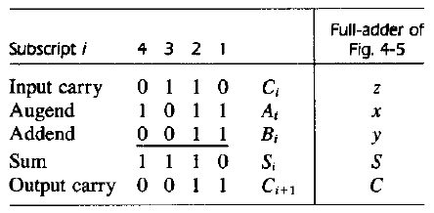
Binary Parallel Adder[BPA]
Two binary numbers of n bits each can be added by means of this circuit.
N-bit parallel adder requires N full-adders

Slide 3
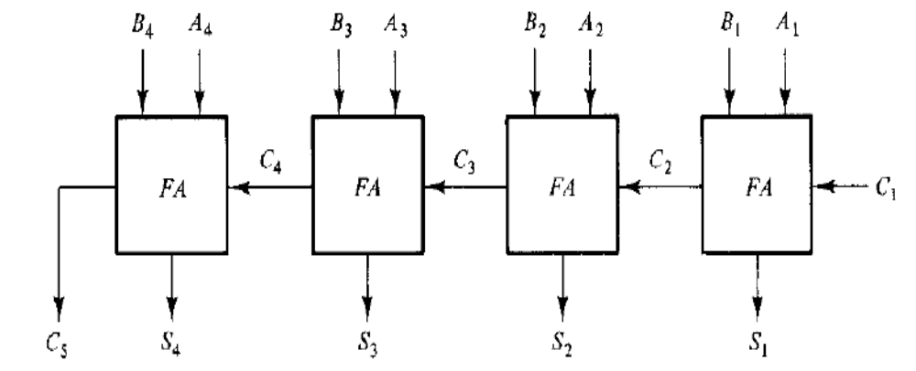
4-bit full adders

Slide 4
Design a 4 bit subtractor
Design a 4 bit Adder-subtractor.
Design a BCD to Excess 3 code converter using binary parallel Adder
Design an Excess 3 to BCD code converter using a 4 bit full adders MSI circuit.
Using 4 MSI circuits, construct a binary parallel adder to add two 16 bit binary numbers. Label all carries between the MSI circuits.

Slide 5
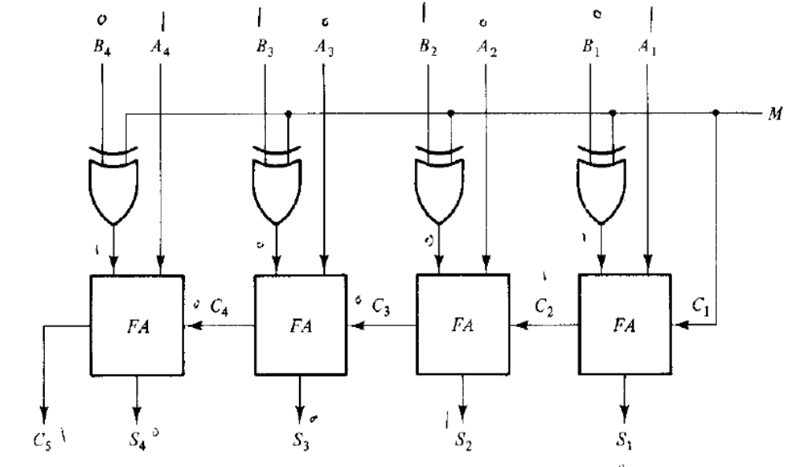
4-bit Binary Adder - Subtractor

Slide 6
Design BCD – Excess – 3 code converter using Binary parallel Adder
Not Used
A1
A2
A3
A4
B1
B2
B3
B4
C5
BCD
input
S1
S2
S3
S4
Excess – 3
Output
1
0
C1

Slide 7
Practise Problems
1. Using (r-1)’s and r’s complement method perform
a) (57)₁₀ – (28)₁₀
b) (432) ₈ – (577)₈
2. Determine the value of base x if
a) (225) _{x} = (341)₈
3. Convert the following hexadecimal numbers into their equivalent decimal and octal numbers
i) (23867)₁₆
ii) (368170.AB) ₁₆
4. Find the minimum Sum of product expression for ∏M(0,1,2,5,7,9,11) using K-map

Slide 8
5. Design an Excess-3 to 5 2 1 1 code converter.
6. a) Implement Full Adder circuit using NOR gates
b) Implement Full subtractor circuit using NAND gates
7. Simplify the following 5 Variable Boolean expression using Quine McClusky method.
F= ∑ m(0,1,9,15,24,29,30) + ∑ d( 8,11,31)

Slide 9
Carry Propagation
Total propagation time = propagation delay * the number of gate levels in the circuit.
The signal from the input carry C_{i}, to the output carry C_{i+1}, propagates through an AND gate and an OR gate, which constitutes two gate levels.
So, Binary parallel adders with 4 full adders, the output carry C₅ would have 2 * 4 = 8 gate levels from C₁ to C₅.
For an n-bit parallel adder, there are 2n gate levels for the carry to propagate through

Slide 10
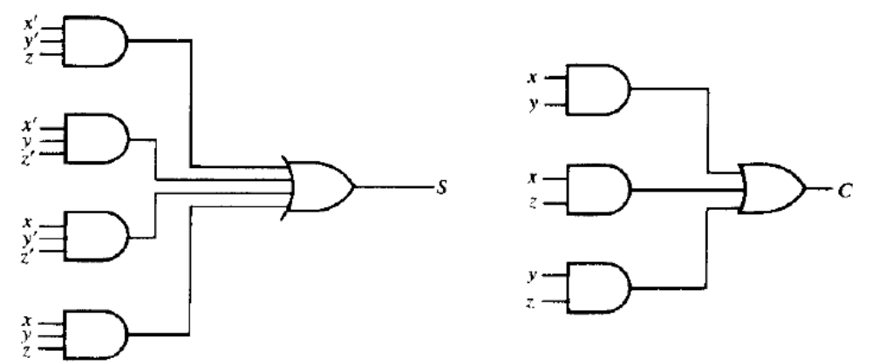
Carry propagation delay

Slide 11
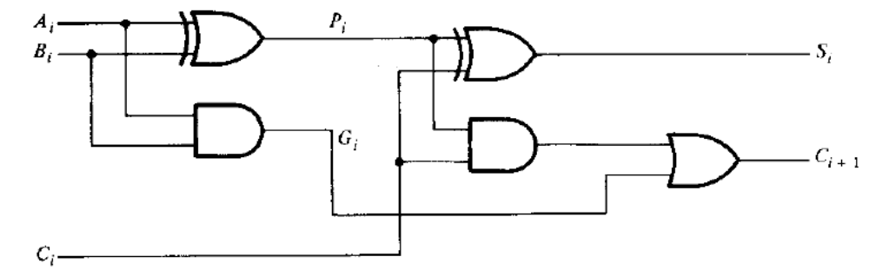
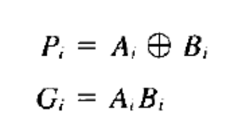
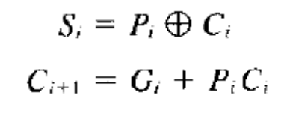
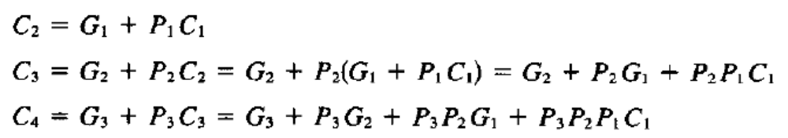
Carry propagation
Full Adder

Slide 12
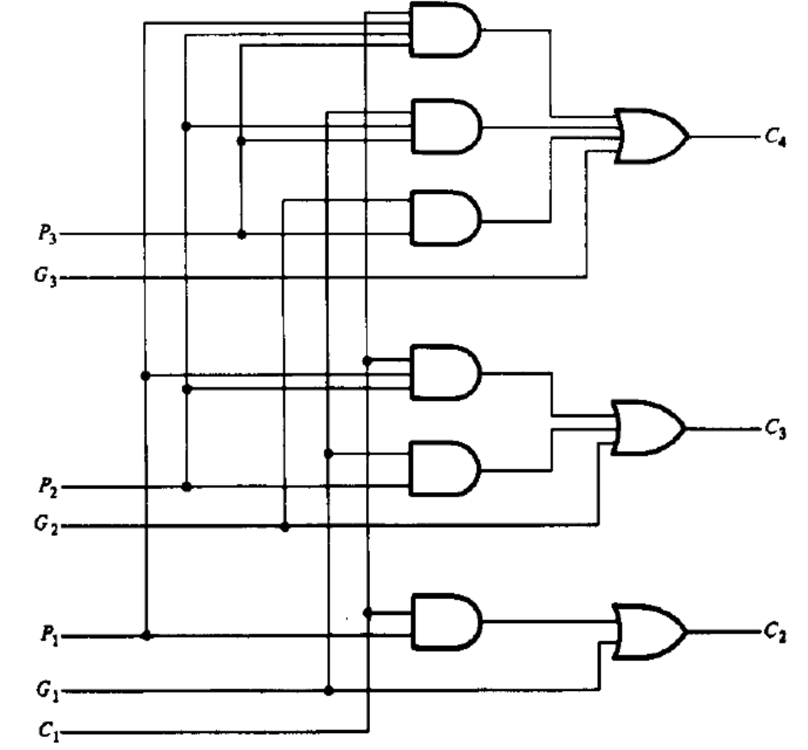
Logic Diagram of a Look-carry generator

Slide 13
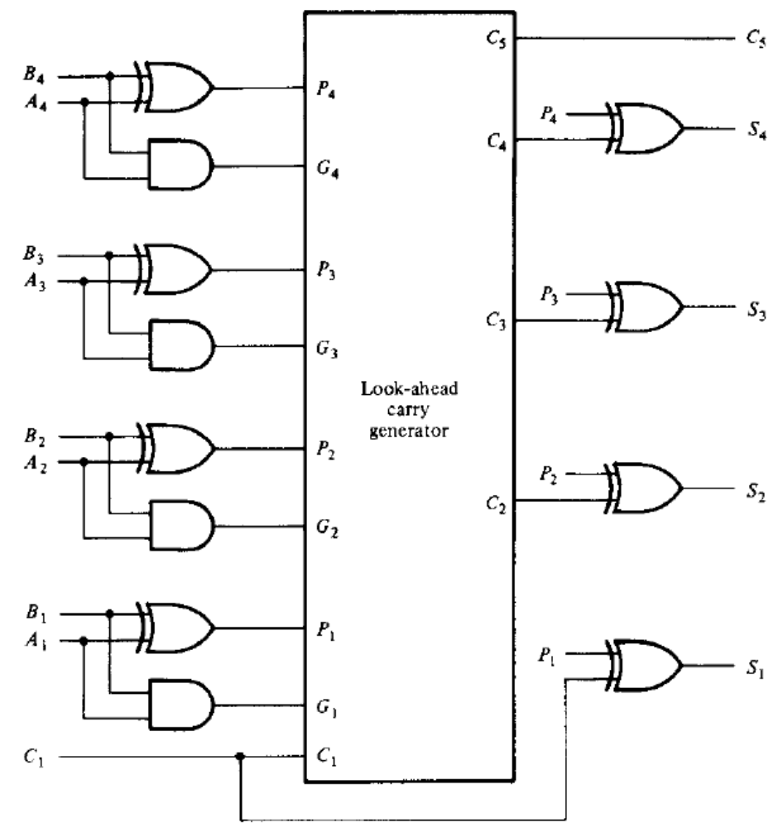
4 – bit Binary Parallel adder with look ahead carry

Slide 14
Questions
Question 5.5 in Morris Mano
Question 5.7 in Morris Mano

Slide 15
References
M. Morris Mano, “Digital Design”, 3rd Edition

